Slide 1



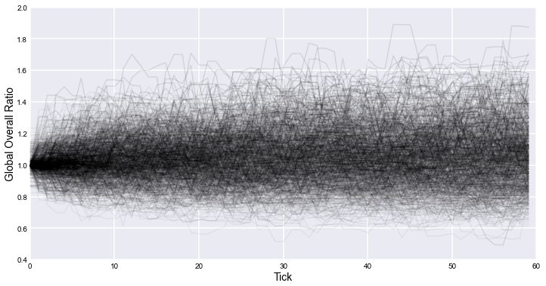
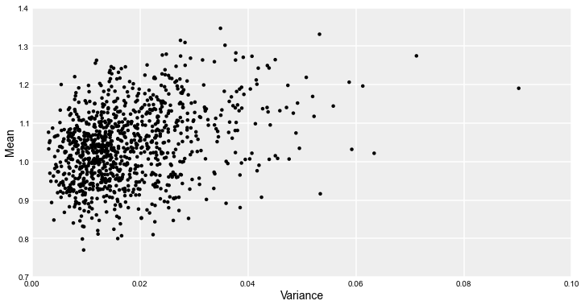
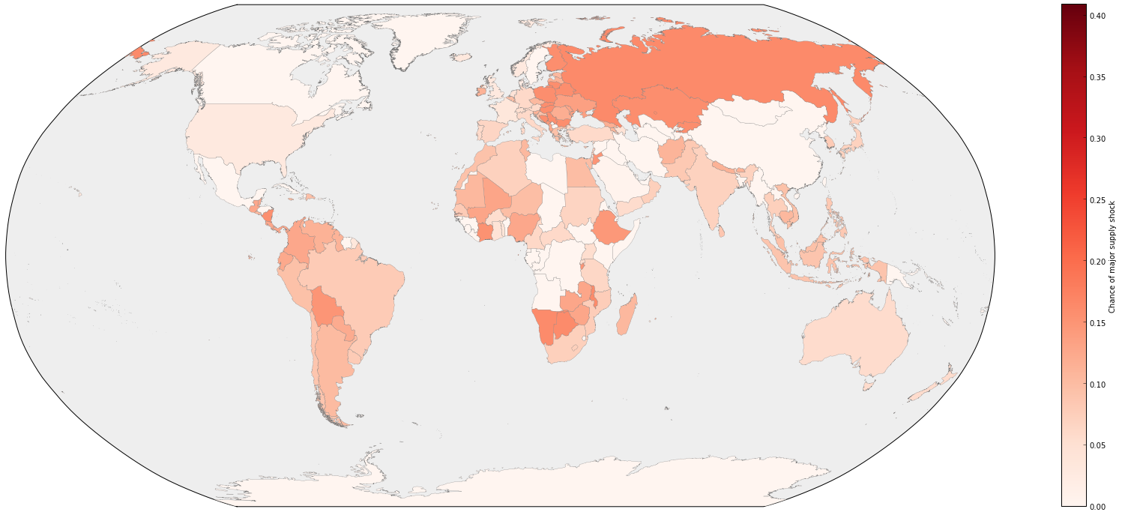
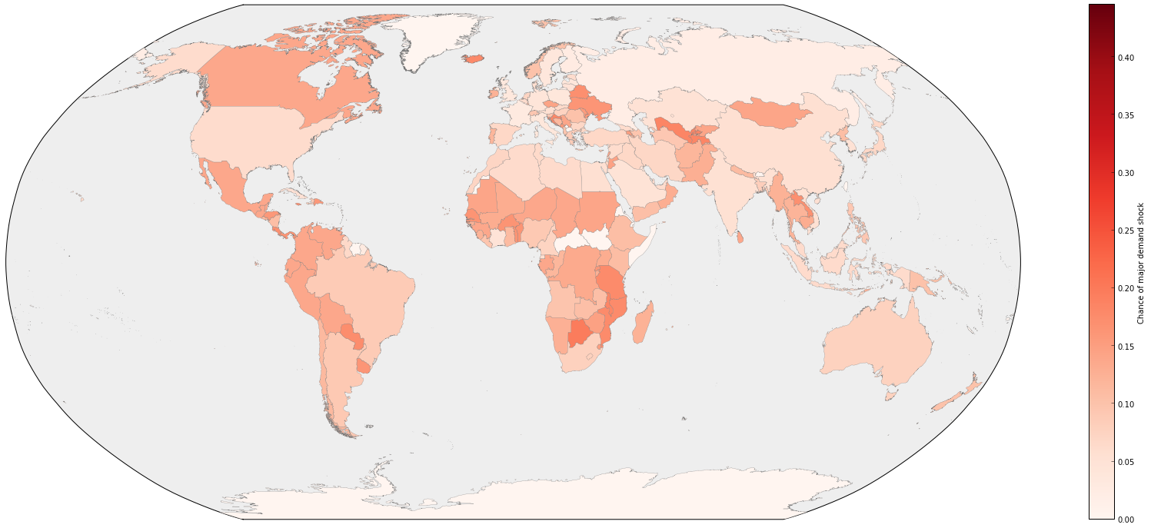
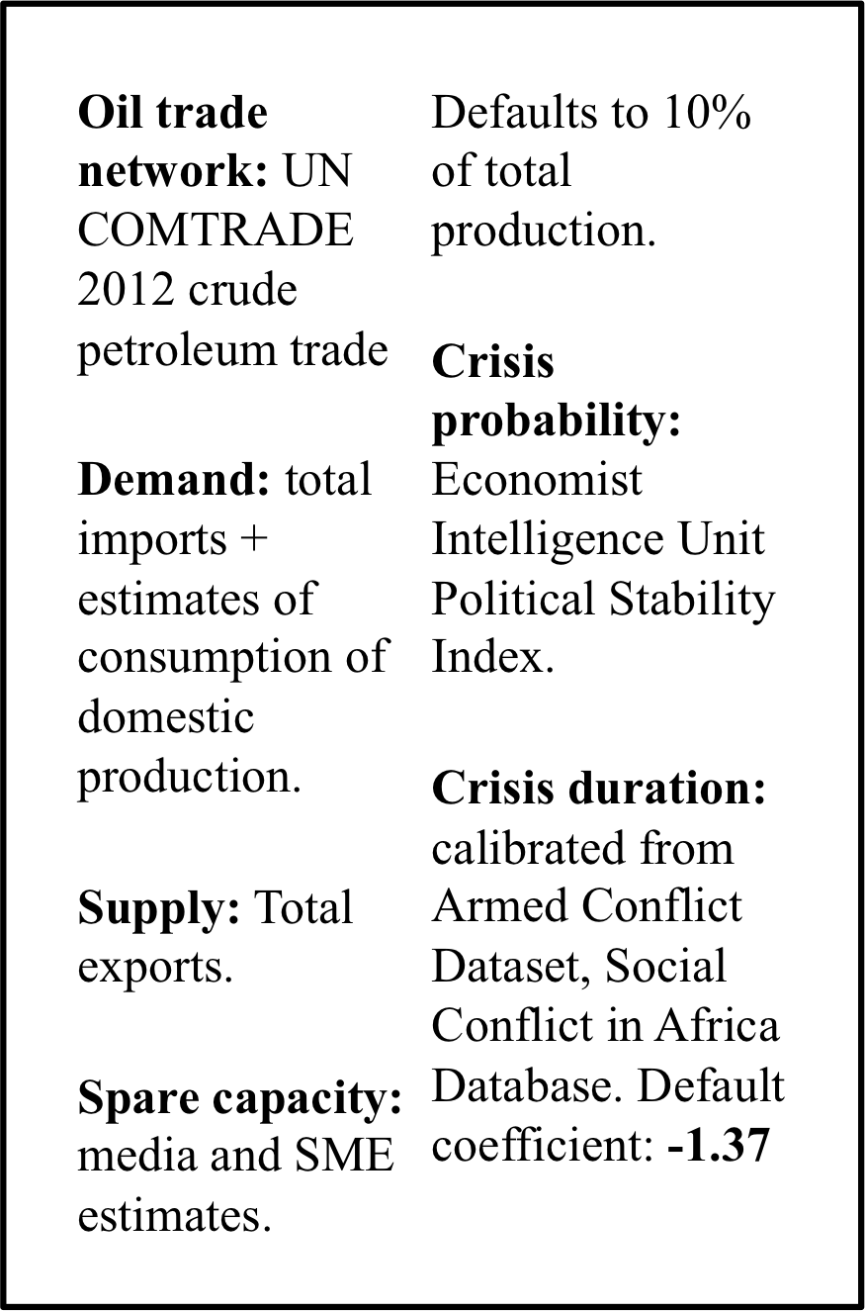
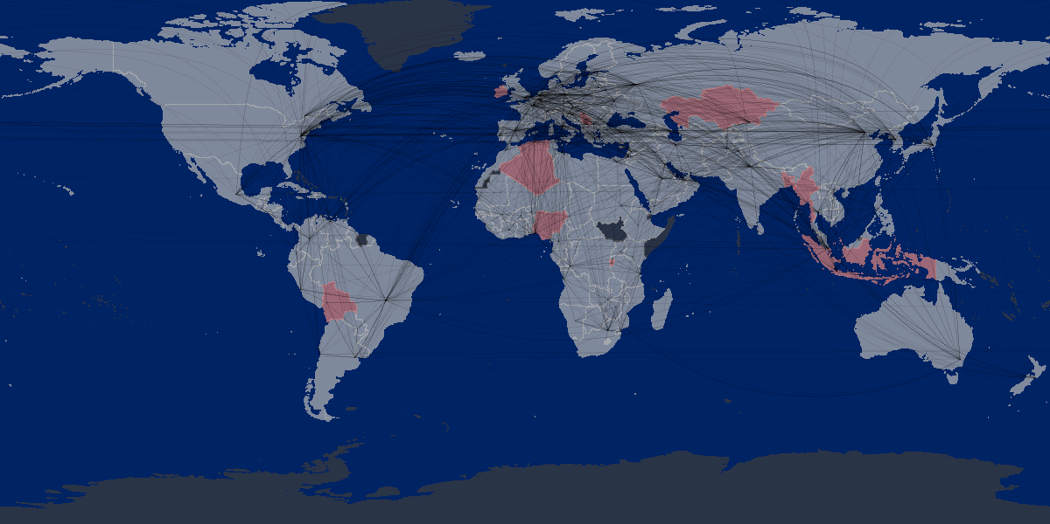
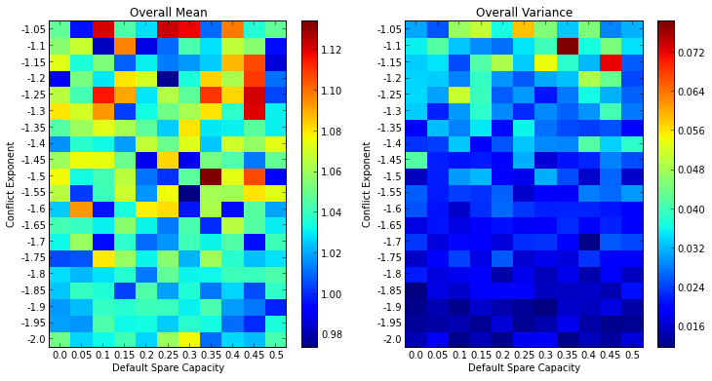
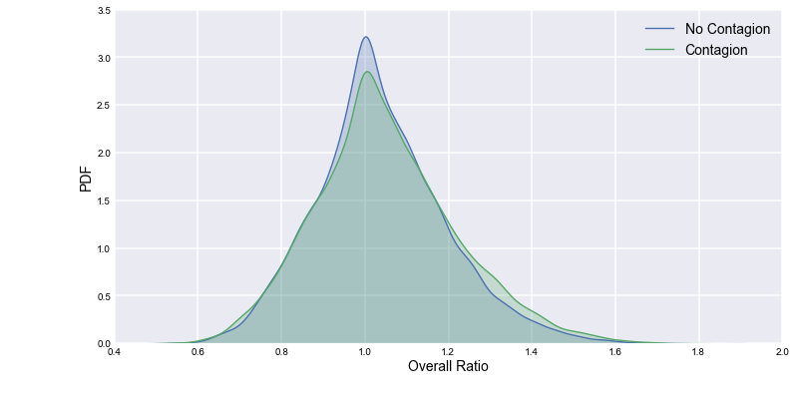
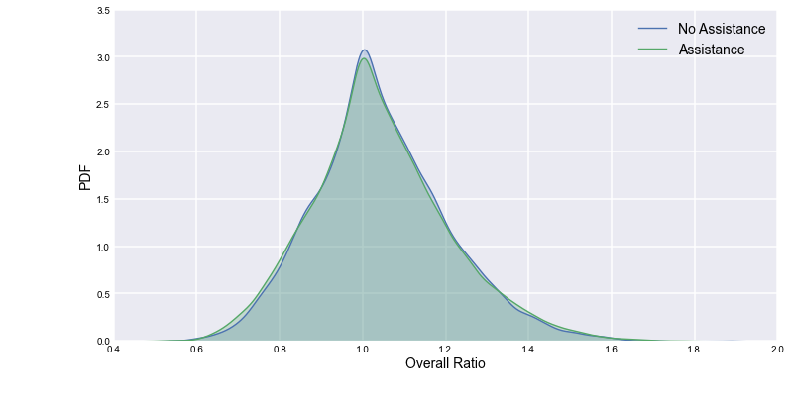
Bv cc
David Masad
Department of Computational Social Science
George Mason University
dmasad@gmu.edu
for Advanced Study
Introduction
Results
Conclusions
Energy Security: “The uninterrupted availability of energy sources at an affordable price” (IEA)
Greatest risk to energy security are supply shocks.
All oil supply shocks since 1970 driven by conflicts or crises (e.g. Gulf War, Venezuela general strike).
Quantitative risk assessments (e.g. IEA’s MOSES) are static, and look at average risks.
Project Objective: Create dynamic, empirically-grounded simulation of energy security, and use it to estimate global and country-level risks.
Model Analysis
Estimated Energy Security, By Run
Extreme oil shocks unlikely, but possible.
Distinguish between two types of insecurity:
    Short-term fluctuations in secure supplies
    Long-term reduction in availability of secure supplies
  Diverse trade partners are important, particularly if conflict contagion is a risk.
  Consumption of domestic production significantly reduces risk of supply shocks, even in the absence of energy independence.
  Countries at greatest supply risk are in the Global South, Eastern Europe.
  Greatest demand risk in the Americas.
  Conflict contagion does increase risks
  Assistance does not, suggesting that spare capacity may not be able to mitigate severe crises.
I ran the model for 1,000 iterations, with each iteration lasting 60 ticks (5 simulated years).
At each tick of each iteration, the model collects and stores three measures of energy security
  Supply Ratio: the fraction of each country’s total demand met by secure supplies.
  Demand Ratio: The fraction of each country’s exports going to secure importers.
  The Global Ratio of total secure demand to total secure supplies, across all countries.
Most scenarios stay within a fairly narrow band, indicating security and stability.
  Occasional spikes are crises, quickly-resolved increases in insecurity.
  Plateaus and troughs indicate shocks which persist over the long term.
Many scenarios are low-variance, even if the mean ratio is extremely high or low. They are insecure but stable.
Model Description
The model consists of country agents, linked geographically by mutual borders and via a crude oil trade network.
Each country has a set supply of, and demand for, crude oil.
Each tick:
  Countries enter crisis at random, with fixed probabilities.
    Crisis lengths are drawn from a power law distribution.
    If conflict contagion is enabled, crises may spread from a country to its neighbors.
  The oil exported from, and imported to, countries in crisis is considered to be insecure.
If Assistance enabled, if a country is experiencing a supply shock, its trade partners that are not in crisis may temporarily increase their production. This increases their exports to all their trade partners as well.
Estimated Country-Level Risks
For each country, I compute the fraction of iteration-months in which the country experiences a supply or demand crisis, defined as a supply ratio ≥2 or a demand ratio ≤0.5.
Future Work
Supply Risk
Demand Risk
Data Sources
Model GUI
Effects of Contagion and Assistance
Sensitivity Analysis
The model has a GUI that allows users to monitor runs and conduct experiments:
Induce or suppress crises, and set their duration.
Change countries’ risk, domestic-production consumption, and spare capacity.
Change global coefficient on crisis length distribution.
All inputs and parameters are stored in standard CSV files for easy modification.
In order to determine the effect of the conflict contagion and assistance mechanisms, I turn each on and off and examine the distribution of the global ratios across all iteration-months.
I conduct a sensitivity analysis by varying the conflict power law coefficient between -1.05 and 2.00 and the default spare production capacity between 0% and 50%, measuring the estimated global ratio mean and variance generated for each.
There does not appear to be a tipping point which changes the qualitative results of the model. The overall behavior is robust to different parameter values.
Effect of Conflict Contagion
Effect of Assistance
References
Conflict contagion has a small but statistically significant effect, and increases the probability of extreme supply shocks.
Assistance had no statistically significant effect. This appears to be due to the fact that crises in the countries most capable of offering meaningful assistance are themselves the cause of major supply shocks.
Notes:
Copyright Colin Purrington (http://colinpurrington.com/tips/academic/posterdesign).

